Slide 1



Crop Disease Detection using Deep Learning
A Python + PyTorch Based AI System
Presented by: Udita Sarkar Chandrabindu
Course: CIT-316 (AI Project)
Notes:
1

Slide 2

Introduction: Revolutionizing Agriculture with AI
This project introduces an innovative AI system designed to identify crop diseases from leaf images. By leveraging a sophisticated deep learning model, it analyzes plant leaf characteristics to predict specific diseases, offering a transformative tool for modern agriculture.
Our goal: Make farming easier, faster, and more accurate using AI.
All data is meticulously collected from Mendeley Data, specifically a comprehensive dataset of 23,000 entries contributed by Prem Kumar E.
Notes:
2

Slide 3





The Urgent Need: Why This Project Matters
Early Detection Challenges
Consequences of Misdiagnosis
Inefficiency of Manual Methods
Farmers struggle with identifying early-stage diseases, leading to significant delays in treatment and potential crop loss.
Incorrect disease identification often results in inappropriate treatments, further exacerbating crop damage and financial losses.
Traditional manual checking is time-consuming, labor-intensive, and prone to human error, hindering timely intervention.
AI for Rapid Accuracy
Informed Treatment Decisions
AI offers a powerful solution, capable of detecting diseases swiftly and accurately from visual data, empowering farmers with precise information.
With quick and accurate diagnoses, farmers can make informed decisions on the right treatment, minimizing crop loss and optimizing yields.
Notes:
3

Slide 4


The Engine: PyTorch Deep Learning Framework
At the core of this project is PyTorch, a leading open-source machine learning framework renowned for its flexibility and power in deep learning applications.
Developer-Friendly Debugging
PyTorch offers an intuitive interface that makes debugging neural networks significantly easier and more efficient.
Flexibility for Experimentation
Its dynamic computational graph allows for greater flexibility, making it ideal for research and experimental model development.
GPU Acceleration
Leverages Graphics Processing Units (GPUs) for dramatically faster model training and inference, crucial for large datasets.
Seamless Python Integration
Works smoothly with Python-based Graphical User Interfaces (GUIs) like Tkinter, ensuring a cohesive user experience.
PyTorch is a top choice for computer vision tasks due to its robust ecosystem and active community support.
Notes:
4

Slide 5





The Brain: Inception v3 Deep Learning Model
This project employs Inception v3, a state-of-the-art Convolutional Neural Network (CNN) architecture, specifically chosen for its superior performance in image recognition tasks.
Exceptional Accuracy
Achieves high precision in classifying diverse leaf diseases, even subtle variations.
Fine Feature Detection
Designed to detect minute spots and intricate textures, crucial for early disease identification.
Efficient Training
Optimized for faster training times without compromising on performance.
Proven in Research
A well-established and highly-regarded model in academic and research communities.
The Inception v3 model is meticulously trained on our specialized crop dataset to ensure accurate disease recognition.
Notes:
5

Slide 6
From Leaf to Diagnosis: How the Model Works
Understanding the step-by-step process of disease detection with Inception v3.
01
02
03
Input Leaf Image
Image Preprocessing
Feature Extraction by Inception v3
The user provides an image of a plant leaf, ideally with clear focus and lighting.
The input image undergoes essential transformations, including resizing, normalization, and color adjustments, to optimize it for the model.
The Inception v3 model processes the image, extracting complex visual features indicative of plant health or disease.
04
05
Comparison with Known Diseases
Output & Confidence Score
These extracted features are then compared against a vast database of known disease patterns learned during training.
The system outputs the predicted disease name along with a confidence score, indicating the likelihood of the diagnosis.
Your trained model weights are stored in: inception_crop_model.pth
Notes:
6

Slide 7
Key Components: Important Project Files
The robust AI system is composed of several critical files, each serving a unique function.
inception_crop_model.pth
Contains the saved, trained Inception v3 model weights.
class_names.json
Stores the human-readable names of all disease classes the model can identify.
build_classnames.py
A utility script to dynamically build the class list directly from the dataset.
Inception.py
The core script responsible for loading the model and making disease predictions.
gui.py
Powers the user-friendly graphical interface for interacting with the system.
inception_debug.py
Used for testing and debugging the model's performance and behavior.
inception_fix.py
Addresses and resolves potential errors encountered during model loading.
These files collectively form the complete, functional AI crop disease detection system.
Notes:
7

Slide 8
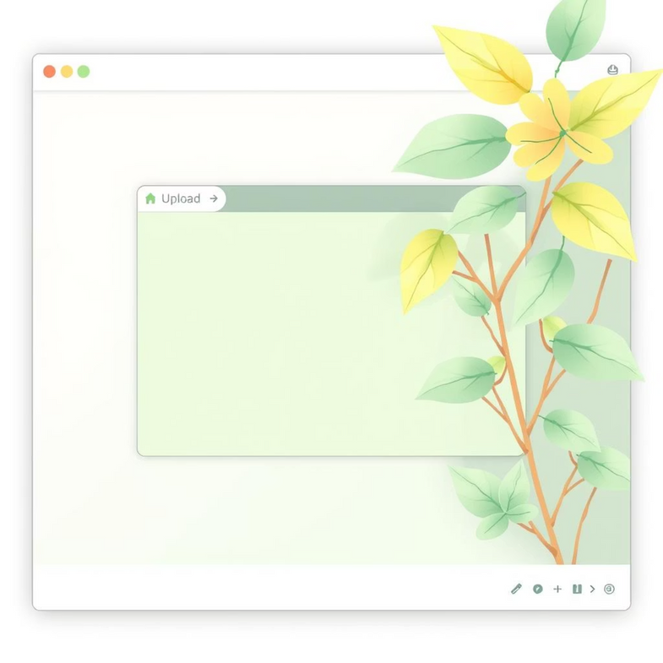
User Interaction: Tkinter Graphical Interface
The application features an intuitive Graphical User Interface (GUI) developed with Tkinter, Python’s standard GUI toolkit.
Lightweight & Built-in
Seamless PyTorch Compatibility
Tkinter requires no external installations, making the application easy to deploy and run.
Integrates perfectly with PyTorch, allowing for smooth data flow from the GUI to the AI model.
Simple Interface Design
Enables easy creation of interactive elements like buttons, labels, and image displays.
The GUI allows users to effortlessly upload a leaf image and receive instant disease predictions, simplifying the diagnostic process for farmers.
Notes:
8

Slide 9





The Journey: System Workflow Overview
A clear, concise breakdown of how the AI system operates from user input to final diagnosis.
Open GUI
User launches the intuitive graphical interface.
Choose Image
User selects a plant leaf image from their device.
Send to Model
Image is securely transmitted to the Inception v3 model.
Model Analysis
Inception v3 rapidly processes and analyzes the leaf image for disease indicators.
Display Results
The GUI presents the detected disease, its probability score, and a clear "Healthy" or "Not Healthy" status.
This entire diagnostic process is completed within mere seconds, providing fast, actionable insights.
Notes:
9

Slide 10





Conclusion: Advancing Agricultural Productivity
This project stands as a testament to the power of AI in transforming agriculture.
Successful Disease Detection
PyTorch & Tkinter Integration
Demonstrates effective and accurate crop disease identification using deep learning.
Highlights a robust development stack for both backend AI processing and frontend user interaction.
Inception v3's Efficiency
Empowering Farmers
Confirms the model's suitability for this application due to its high accuracy and operational efficiency.
Provides tools for faster, more informed decision-making, leading to improved crop health and yields.
Future enhancements could include incorporating more diverse datasets for broader disease coverage and developing mobile deployment options for on-the-go diagnosis.
Thank you!
Notes:
10

